Slide 1
SmartCook
Systems and Software Engineering I Carlo Stock, Shaduan Babbili, (Lily Djami)

Slide 2
Imagine:
Being hungry
Not wanting to waste any food
Having no idea what to cook with your ingredients
Being lazy
Solution: SmartCook

Slide 3
What are we doing?
Easier and faster way to get recipes
Recipes that ADAPT to YOU
Recipes that FIT YOU

Slide 4
Topics
Requirements
Use Cases
System Architecture
Team
Challenges and Risks
Tests
Demo
Future

Slide 5
Requirements

Slide 6
Requirements
Easy to understand structure
Easy to use
Picture restrictions should be user friendly
Good classification rate (50%)
User should be able to fix mistakes

Slide 7
Requirements
Should be operational 24/7
Queries should be fast (2min max)
Personalisation

Slide 8
Picture Requirements
Good amount of lighting
Distinguishable, clean background
Camera angle
Size of objects
Position of objects
NO amount/number of ingredients gets recognized

Slide 9
Use Cases

Slide 10
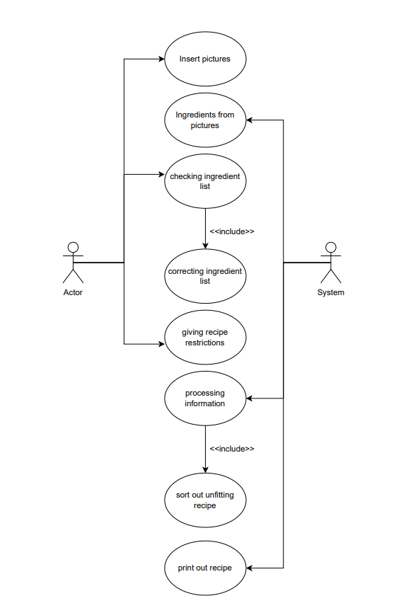
Use Cases

Slide 11
System Architecture

Slide 12
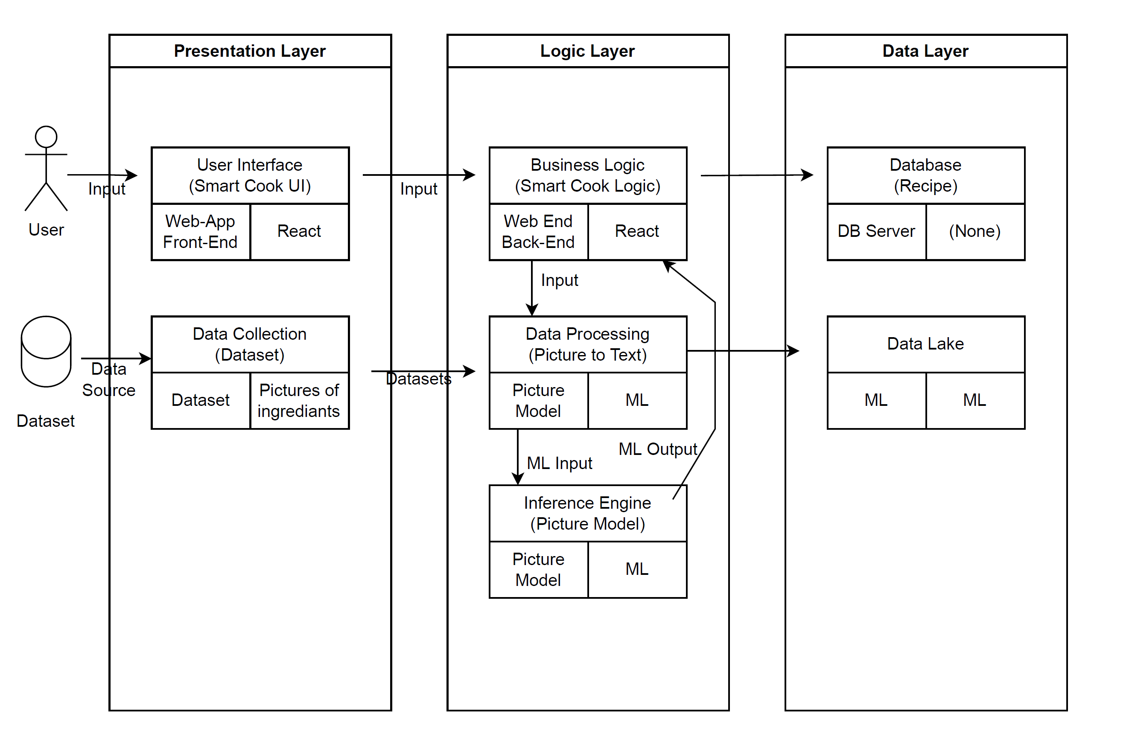
System Architecture

Slide 13
Team

Slide 14
Team
Team Lead: Shaduan Babbili
Back-End Developer: Carlo Stock
Front-End Developer: Carlo Stock
Front-End Designer: Shaduan Babbili
(Image/Ingredient recognition: Lily Djami)

Slide 15
Challenges and Risks

Slide 16
Challenges and Risks
Limited API calls per day
Quality of recipes
Design
Machine Learning + Datasets
Integration

Slide 17
Tests

Slide 18
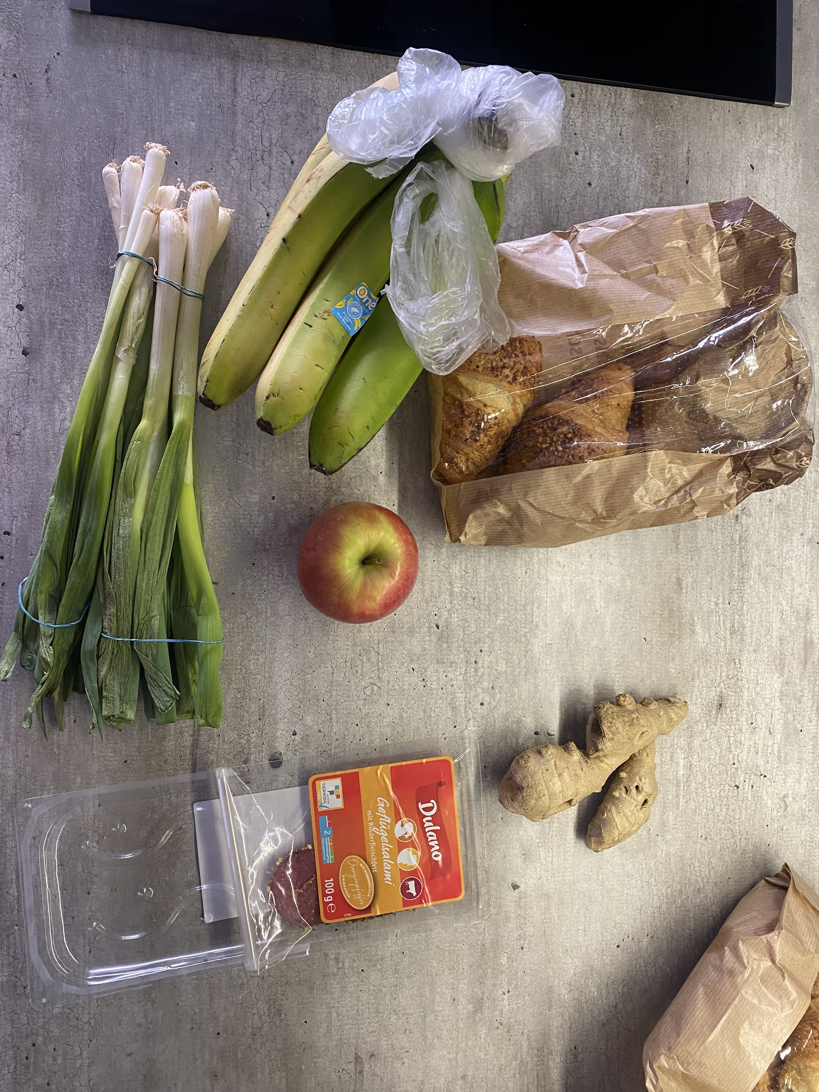
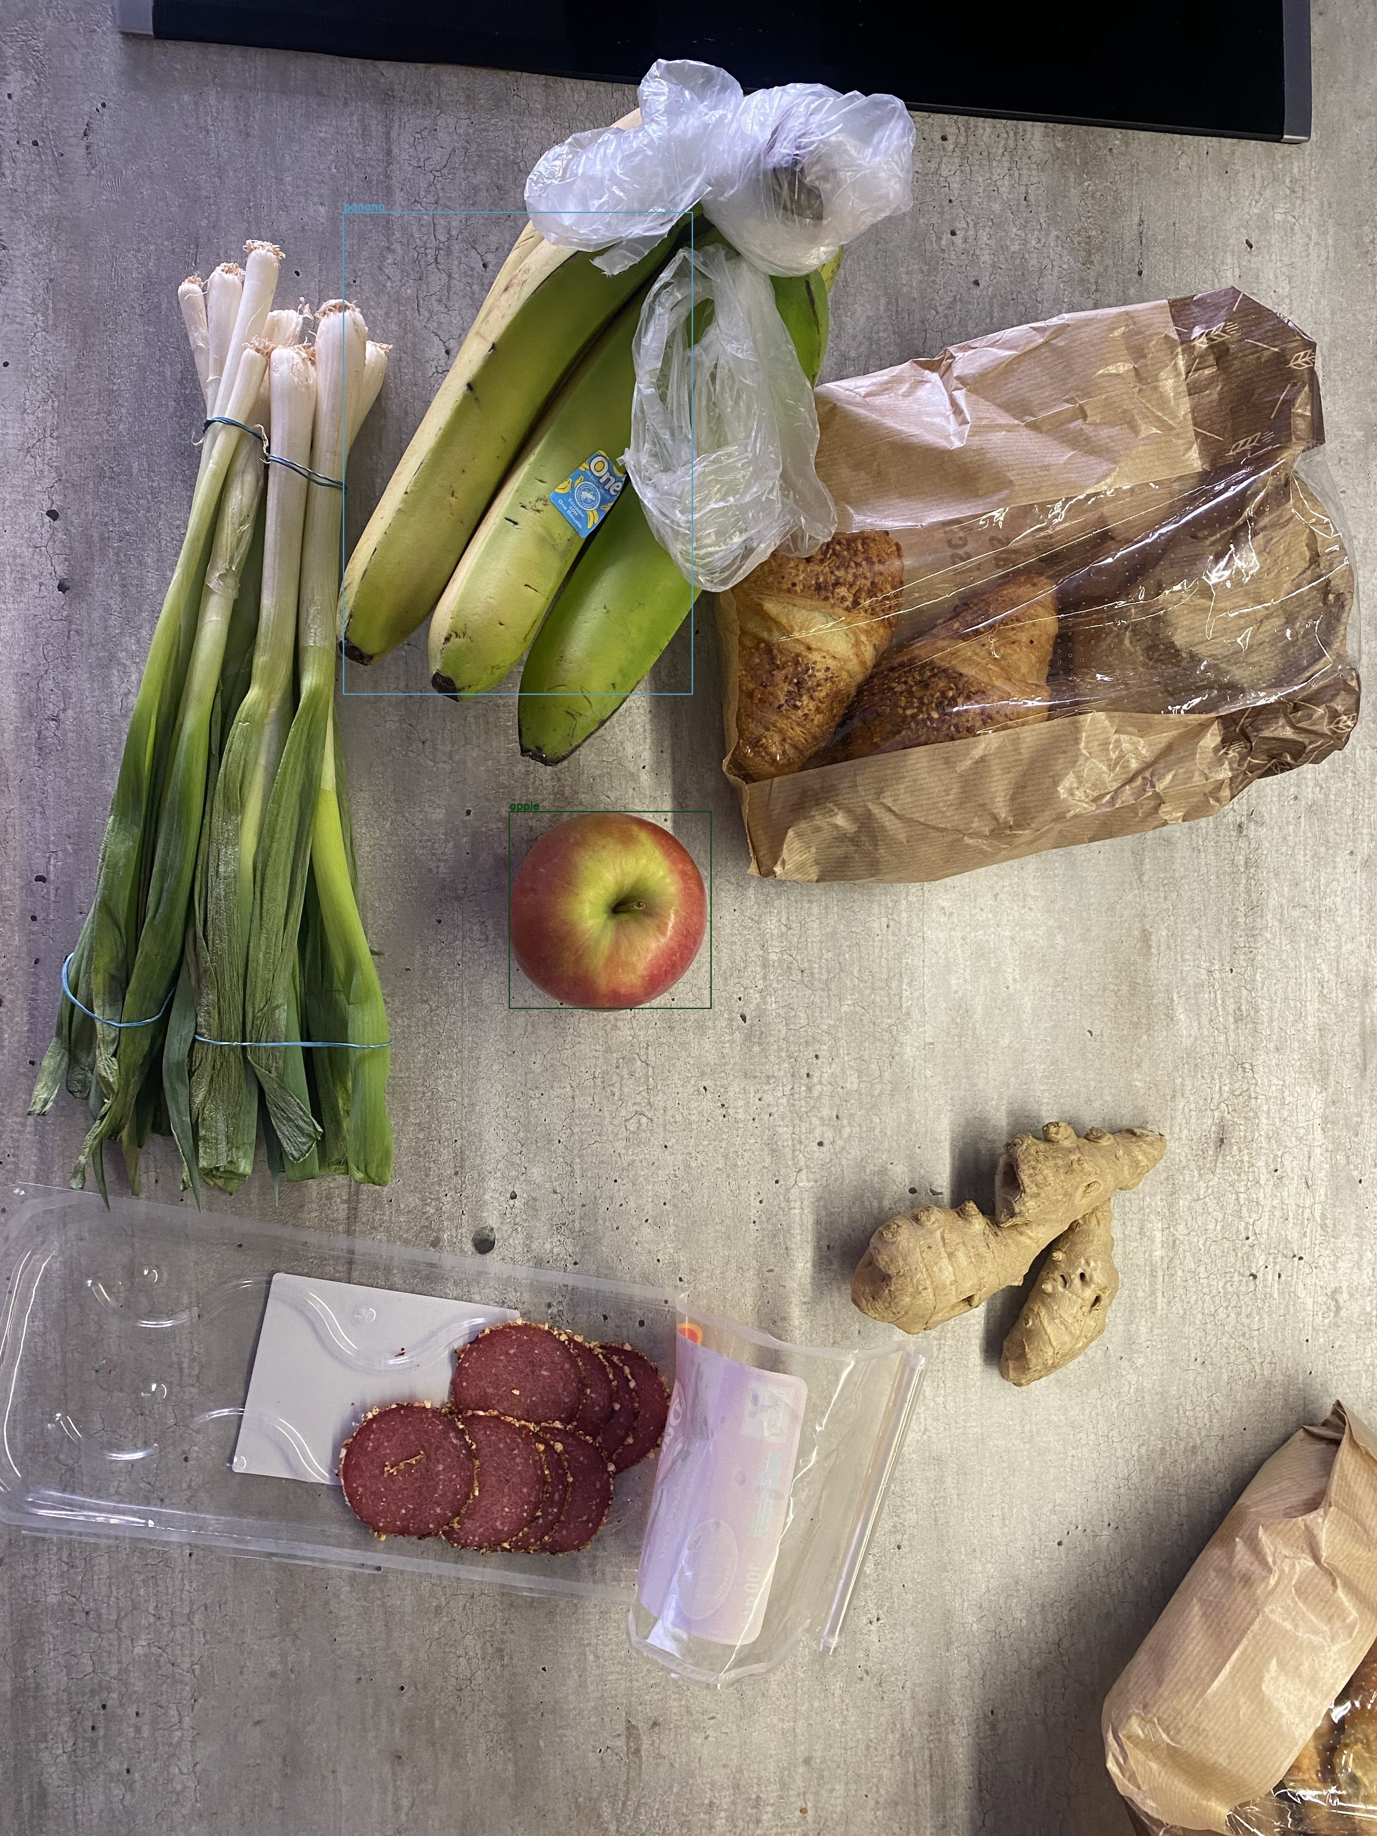
Tests

Slide 19
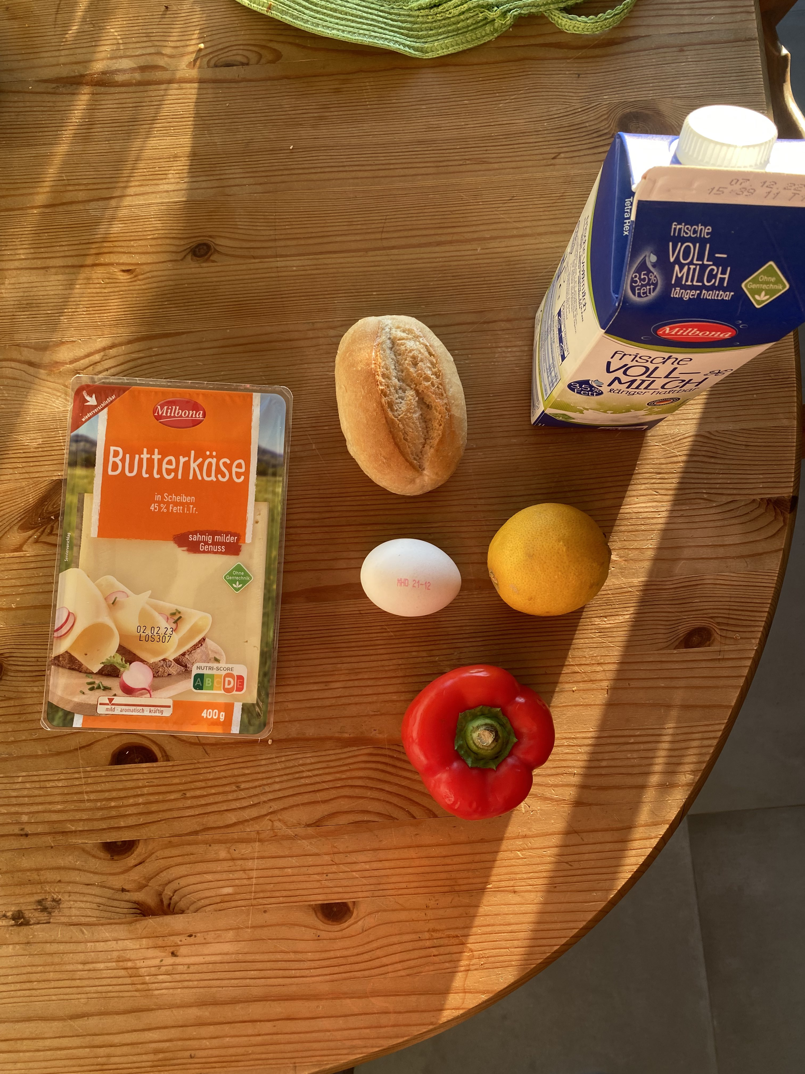


Tests

Slide 20
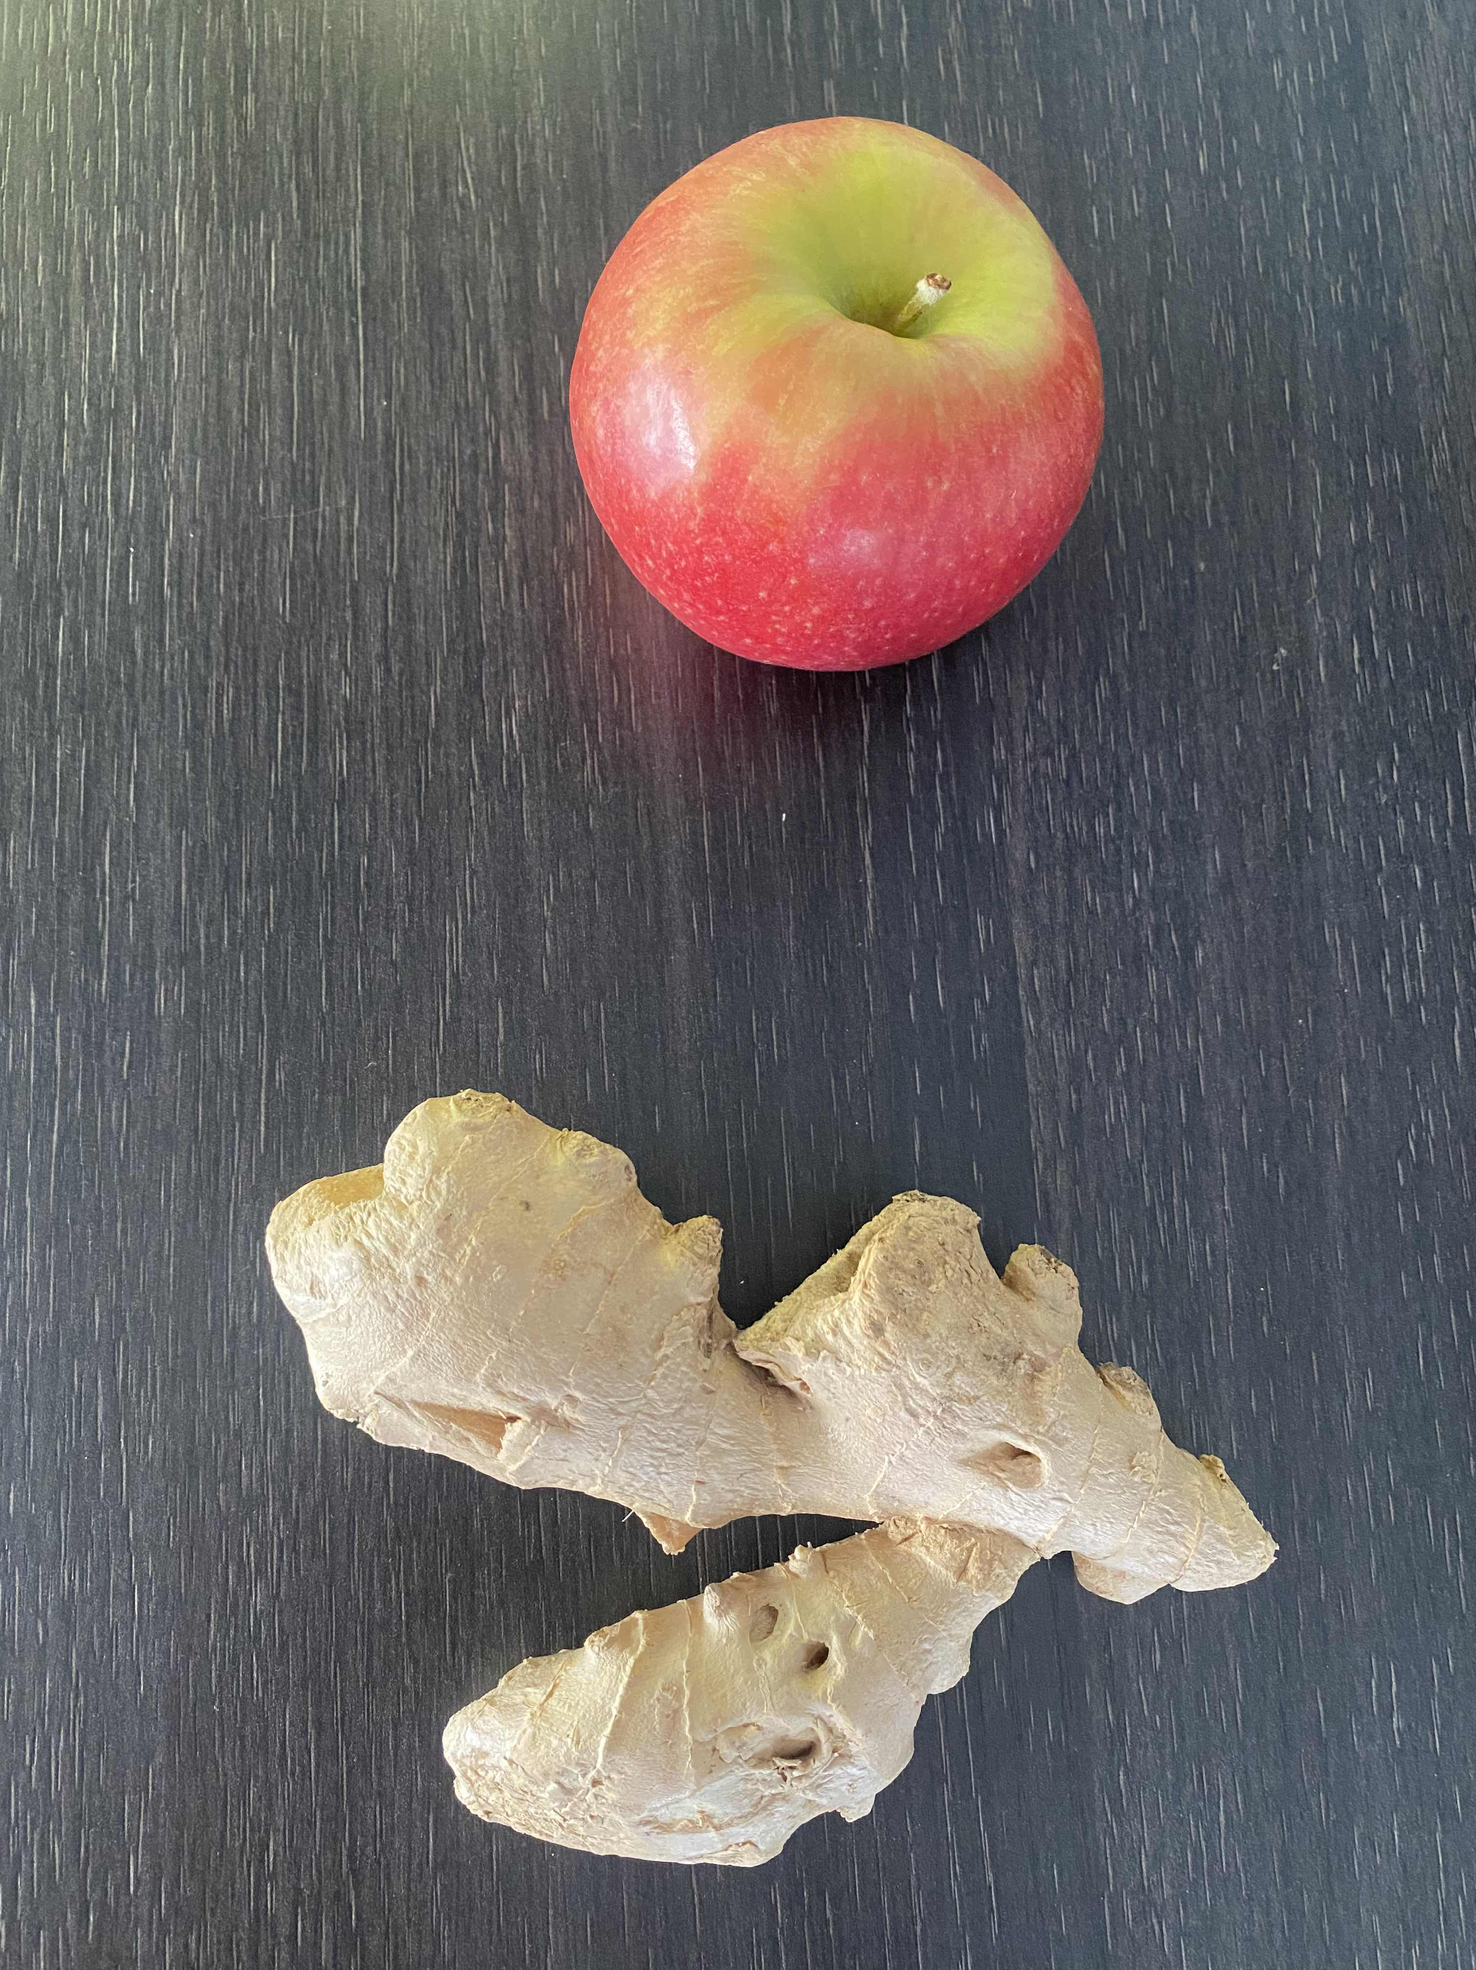
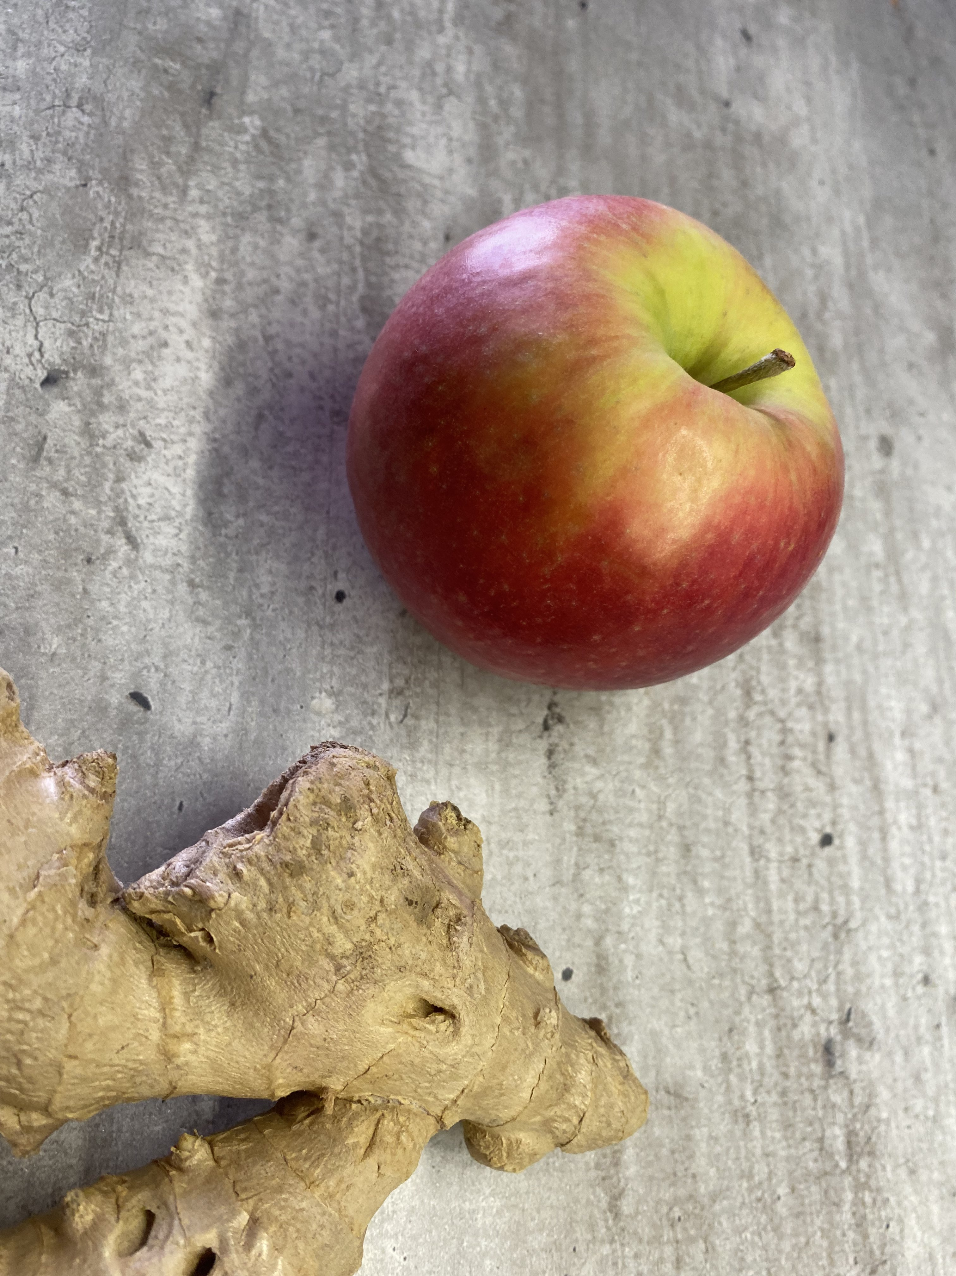
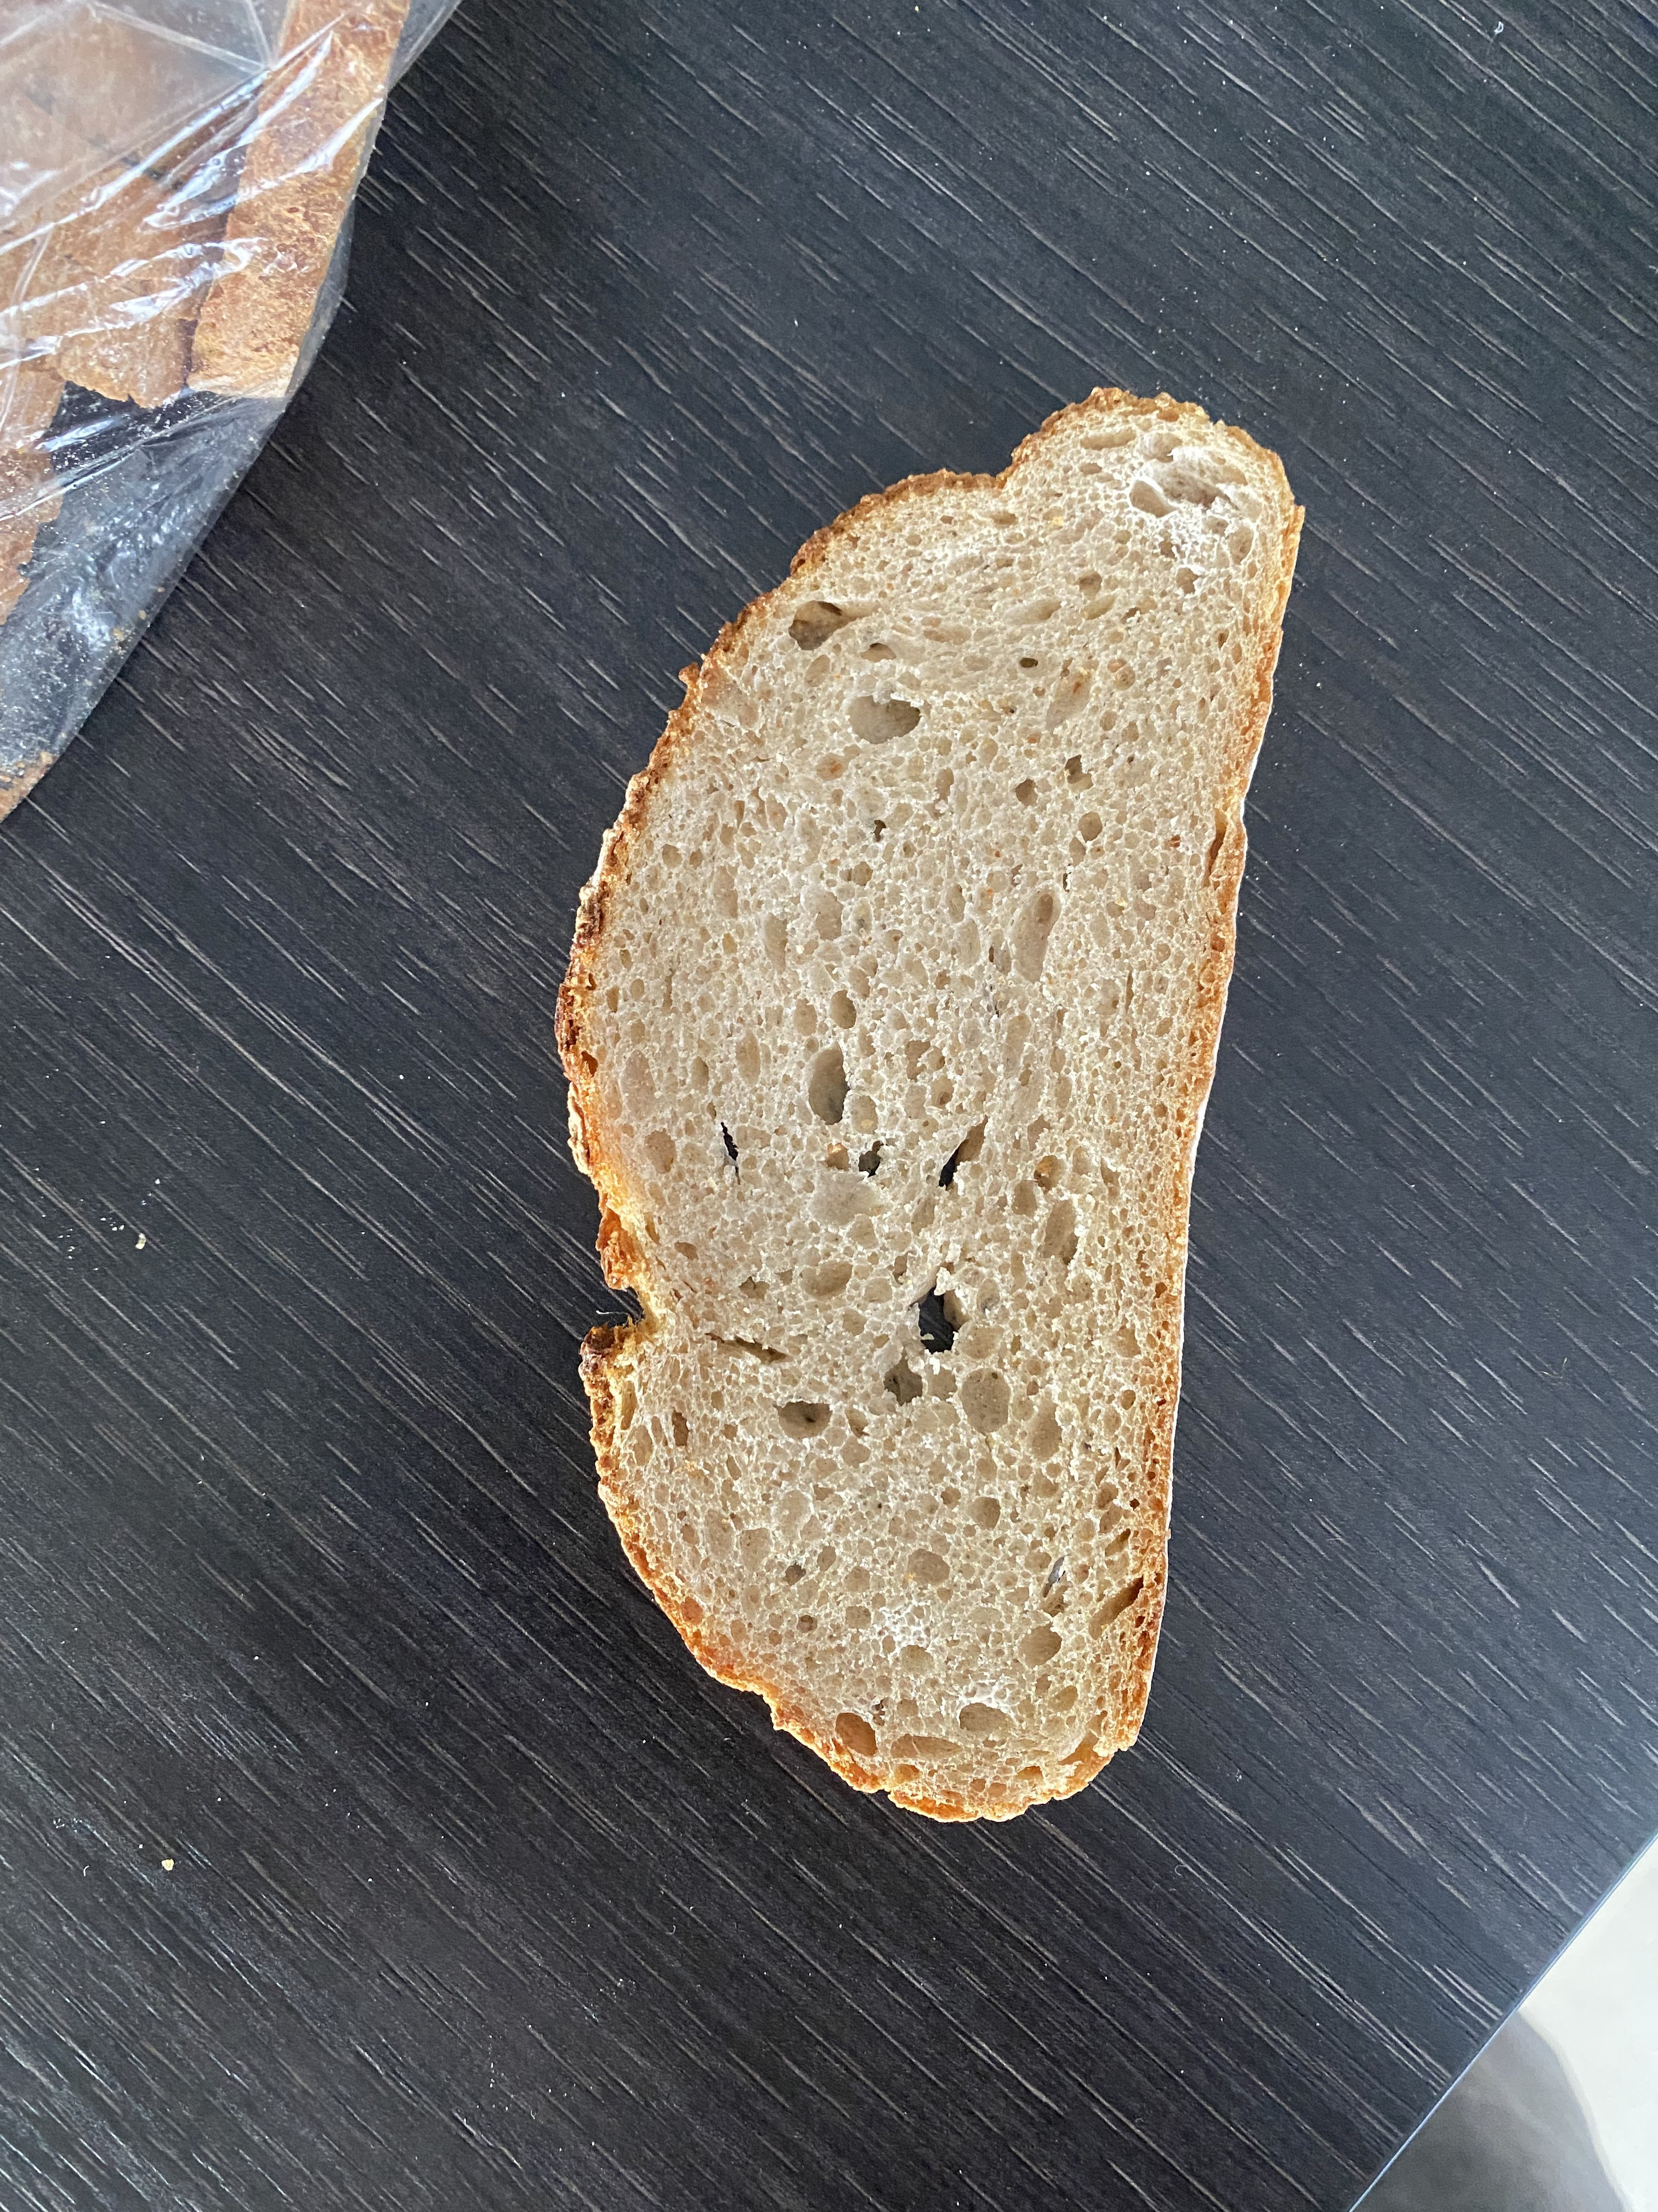
More Tests

Slide 21
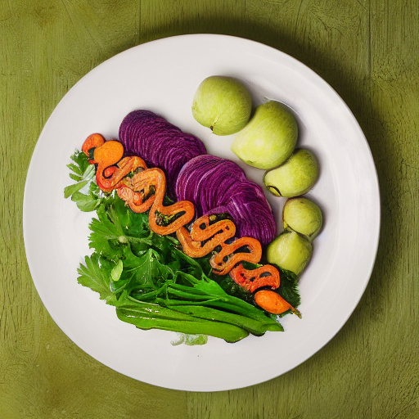
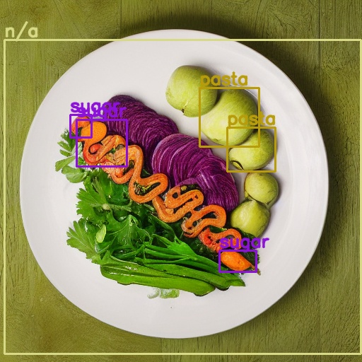
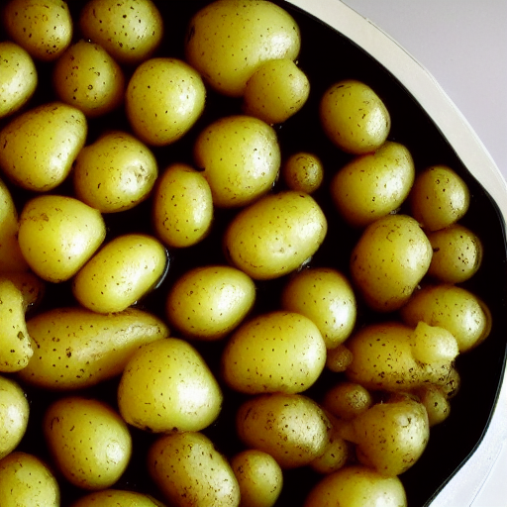
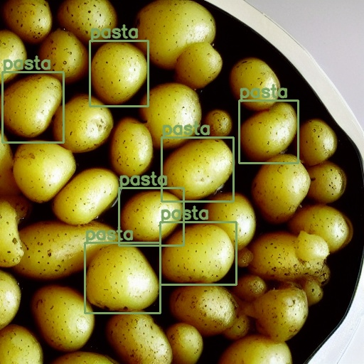
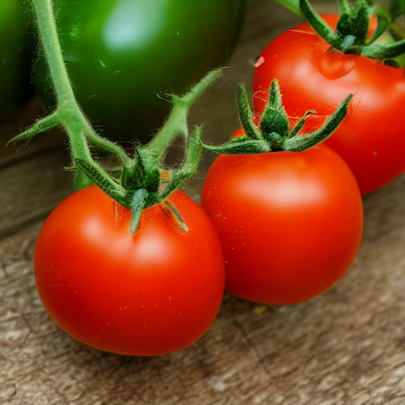
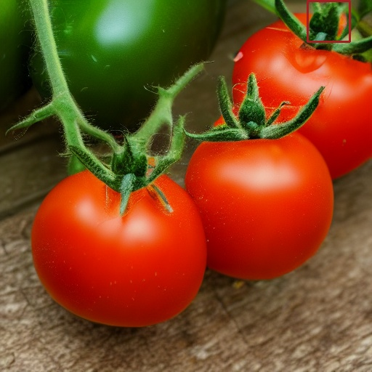
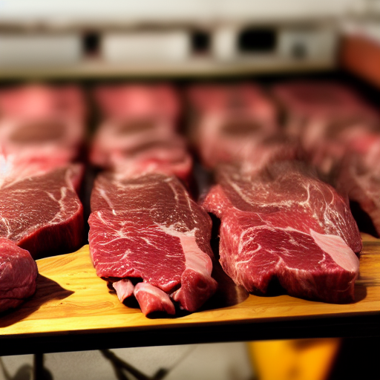

Even More Tests

Slide 22
Demo

Slide 23
Future

Slide 24
Future
Integration of ML
Improve design
Improve ML part – better datasets?
→ very good documents for improving

